Slide 1
Lecture Notes Mean, Variance, and Standard Deviation, and Unusual Values
Ruisheng Zhao
OER – www.helpyourmath.com

Slide 2
What is the MEAN? How do we find it?
The mean is the numerical average of the data set, and we use the mean to describe the data set with a single value that represents the center of the data. Many statistical analyses use the mean as a standard measure of the center of the distribution of the data.
The mean is found by adding all the values in the set, then dividing the size of the data set.

Slide 3
Mean formula
Population mean (µ) is the average of all x values in the entire population, and it’s size is N.
$$µ=\frac{\sum_{i=1}^{N}{x_{i}}}{N}=\frac{x_{1}+x_{2}+x_{3}+…+x_{N}}{N}$$
Sample mean ($\overline{x}$) is the average of all x values in the sample, and it’s size is n.
$$\overline{x}=\frac{\sum_{i=1}^{n}{x_{i}}}{n}=\frac{x_{1}+x_{2}+x_{3}+…+x_{n}}{n}$$

Slide 4
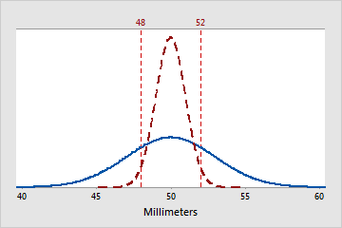
What is the VARIANCE?
The variance measures how spread out the data are about their mean. The variance is equal to the average of the standard deviation squared. The greater the variance, the greater the spread in the data.

Slide 5
Variance Formula
Population variance ($σ^{2}$) is the sum of squared deviations from the mean divided by population size(N).
$$σ^{2}=\frac{\sum_{i=1}^{N}{{(x_{i}−\overline{x})}^{2}}}{N}=\frac{{(x_{1}−\overline{x})}^{2}+{(x_{2}−\overline{x})}^{2}+…+{(x_{N}−\overline{x})}^{2}}{N}$$
Sample variance ($s^{2}$) is the sum of squared deviations from the mean divided by sample size(n)-1.
$${ s}^{2}=\frac{\sum_{i=1}^{n}{{(x_{i}−\overline{x})}^{2}}}{n−1}=\frac{{(x_{1}−\overline{x})}^{2}+{(x_{2}−\overline{x})}^{2}+…+{(x_{n}−\overline{x})}^{2}}{n−1}$$

Slide 6
What is the STANDARD DEVIATION?
The standard deviation is the most common measure of dispersion, or how spread out the data are about the mean. We use the standard deviation to determine how spread out the data are from the mean. A higher standard deviation value indicates greater spread in the data.

Slide 7
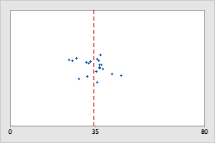
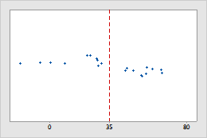
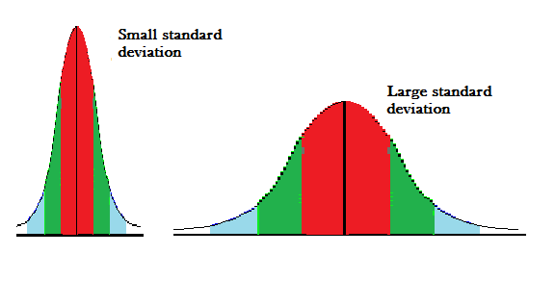
There are two samples chosen from the same population, and their distributions are shown below:

Slide 8
Standard Deviation Formula
Population SD ($σ$) is the positive square root of the population variance.
$$σ=\sqrt{σ^{2}}$$
Sample SD (s) is the positive square root of the sample variance.
$$s=\sqrt{s^{2}}$$

Slide 9
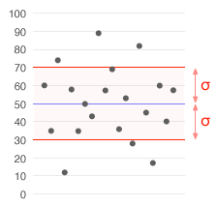
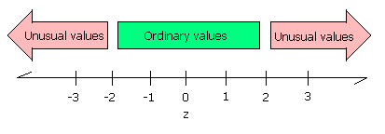
Usual V.S Unusual
By definition, an usual value should lie within 2 standard deviation of the mean is also called usual region. Otherwise, the value is unusual.
Usual region for population:
$$(µ−2σ,µ+2σ)$$
Usual region for sample:
$$(\overline{x}−2s,\overline{x}+2s)$$
2$σ$
2$σ$
Mean=0, SD=1

Slide 10
Example
The population data is given below.
6, 7, 3, 15, 2
Find the mean, variance, standard deviation, and unusual value in the data set?

Slide 11
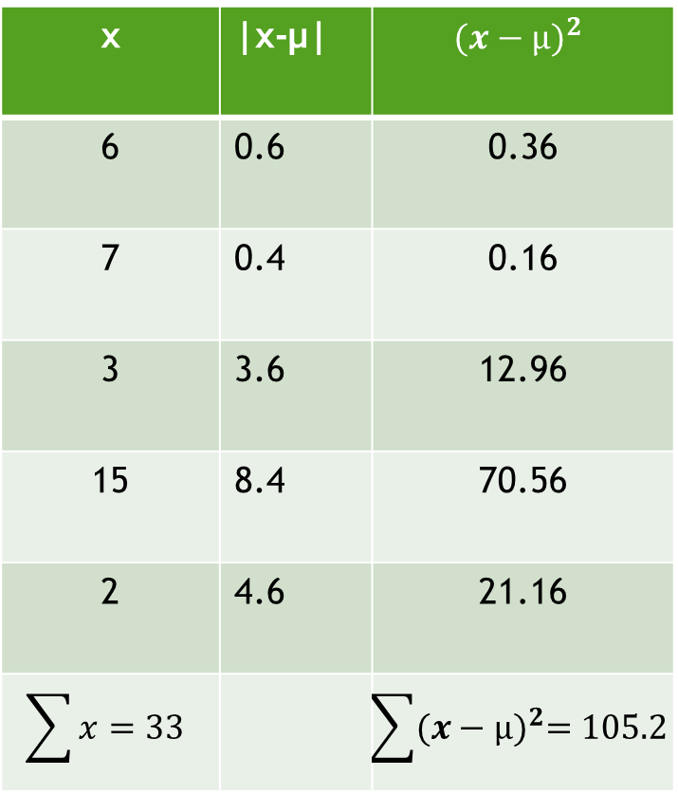
Solution
x | |x-µ| | $${(x−µ)}^{2}$$
6 | 0.6 | 0.36
7 | 0.4 | 0.16
3 | 3.6 | 12.96
15 | 8.4 | 70.56
2 | 4.6 | 21.16
$$\sum{x}=33$$ |  | $$\sum{{(x−µ)}^{2}=105.2}$$
Mean:
µ$=\frac{\sum{x}}{N}=\frac{33}{5}=6.6$
Variance:
$$σ^{2}=\frac{\sum{{(x−µ)}^{2}}}{N}=\frac{105.2}{5}=21.04$$
Standard Deviation:
$$σ =\sqrt{σ^{2}}=\sqrt{21.04}≈4.59$$
Usual Region:
(µ -2 $σ$, µ +2 $σ$)
(6.6-2*4.59, 6.6+2*4.59)
(-2.58, 15.78)
There are not any unusual value since all values in the data set are in the usual region.

Slide 12
Example
A random sample of 10 American college students reported sleeping 3, 12, 7, 8, 6, 5, 6, 4, 5, 9 hours, respectively. What are the sample mean, variance, and standard deviation? Which are unusual values?

Slide 13

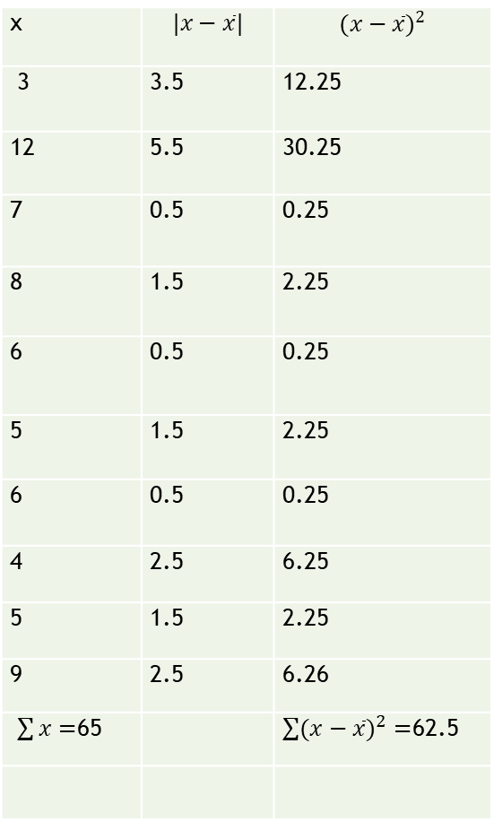
Solution
x | $$|x−\overline{x}|$$ | $${(x−\overline{x})}^{2}$$
3 | 3.5 | 12.25
12 | 5.5 | 30.25
7 | 0.5 | 0.25
8 | 1.5 | 2.25
6 | 0.5 | 0.25
5 | 1.5 | 2.25
6 | 0.5 | 0.25
4 | 2.5 | 6.25
5 | 1.5 | 2.25
9 | 2.5 | 6.26
$\sum{x}=$65 |  | $\sum{{(x−\overline{x})}^{2}}=$62.5
Mean:
$$\overline{x}=\frac{\sum{x}}{n}=\frac{65}{10}=65$$
Variance:
$$s^{2}=\frac{\sum{{(x−\overline{x})}^{2}}}{n−1}=\frac{62.5}{10−1}≈6.94$$
Standard Deviation:
$$s=\sqrt{s^{2}}=\sqrt{6.94}≈2.63$$
Usual Region:
(x-2s,x+2s)
(6.5-2*2.63, 6.5+2*2.63)
(1.24 , 11.76)
Therefore 12 is the unusual value since 12 is outside of the usual region.

Slide 14
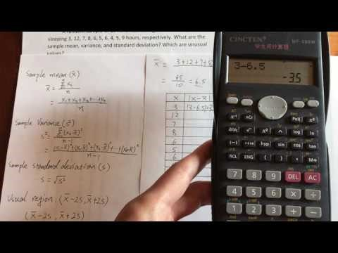
Example YouTube Video https://www.youtube.com/watch?v=SiRWd39-TyU

Slide 15
Practice Exercise
Q1
A population of 10 data shown below:
7, 8, 9, 15,12, 12, 17, 19, 3, 6
Find mean, variance, and standard deviation? Which are unusual values?
Q2
A random sample of 10 American high school students reported playing video game 5, 4, 6, 4, 6, 3, 7, 8, 12, 5 hours a day. Find mean, variance, and standard deviation? Which are unusual values?

